Slide 1
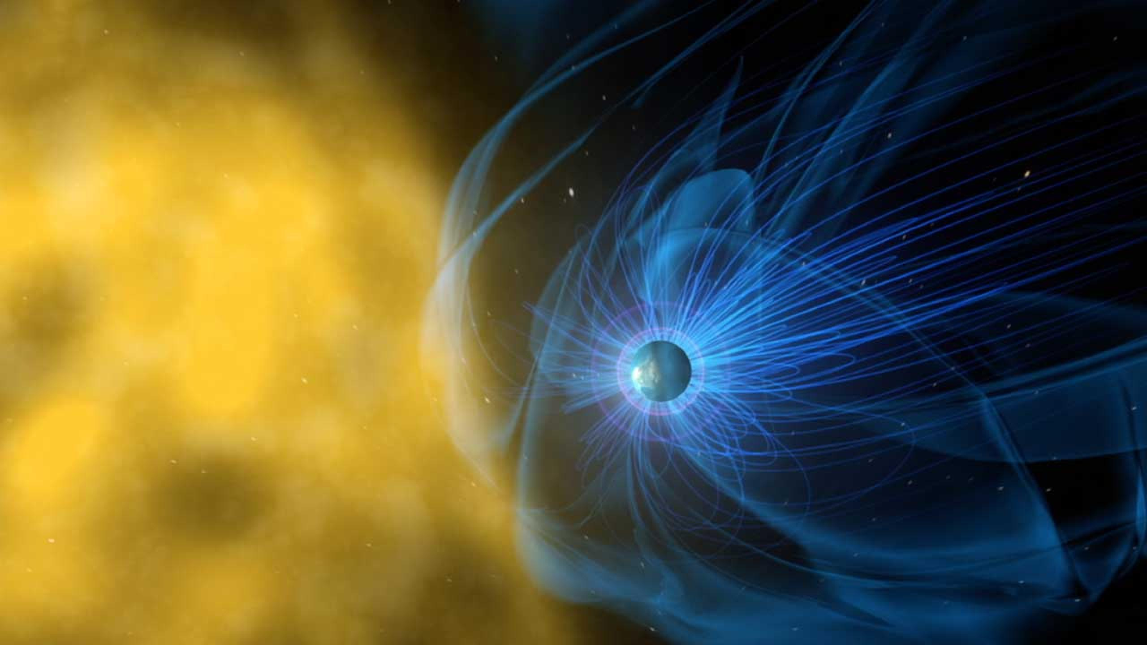



Information Theory and Machine Learning Applications to Solar Wind (SW) and SW-Magnetosphere Interactions
Katariina Nykyri¹, Katherine Holland^{1,2}, Xuanye Ma¹, Simon Wing³, Ernest Scott Sexton¹
1) Embry-Riddle Aeronautical University, 2) NASA Kennedy-Space Center, 3) John Hopkins, Applied Physics Laboratory
Outline:
Information Theory Applications:
A) Solar Wind propagation: ARTEMIS/MMS data and MHD simulations
B) Tracing Plasma Transport Pathways at
Magnetospheric Boundary
Neural Network for Kp Forecasting
Acknowledgements: Information theory work supported by
NASA HSR grant:80NSSC22K0304
ANN work supported by NASA HGI grant: NNX16AF89G

Slide 2
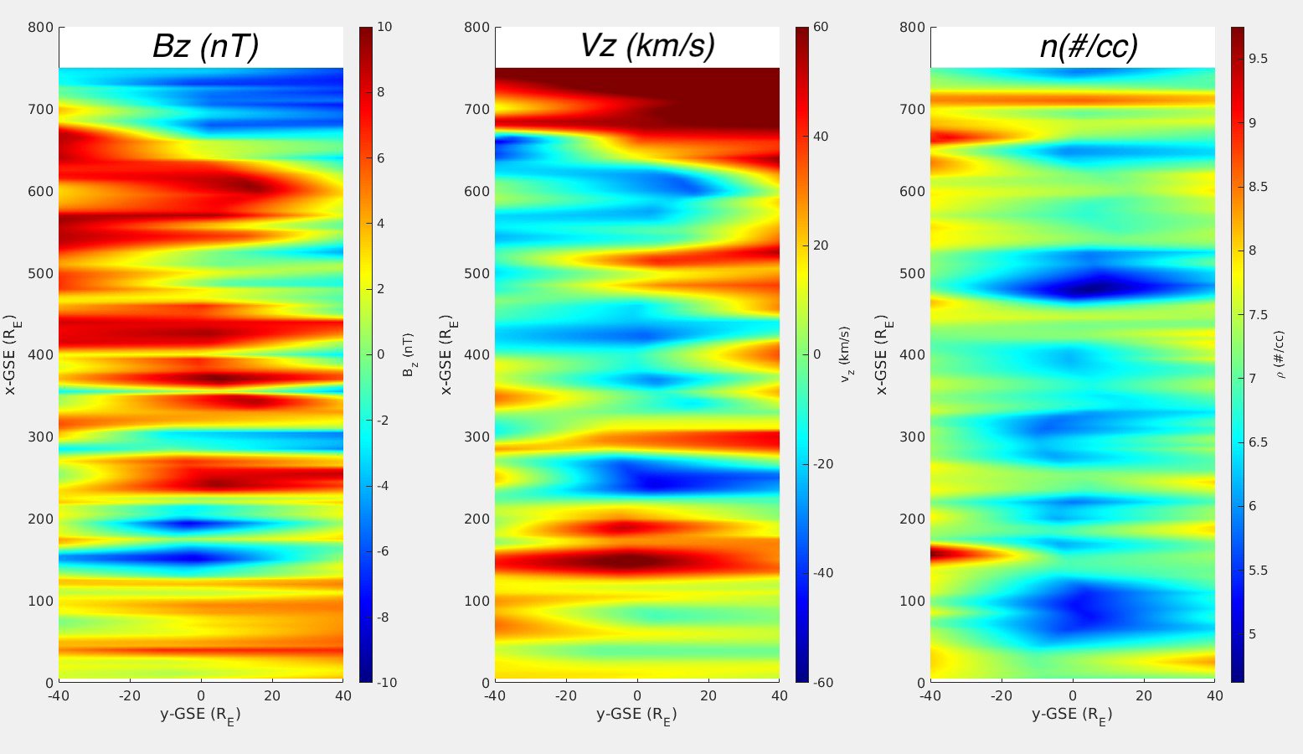
Motivation
A) Solar Wind propagation: ARTEMIS/MMS data and MHD simulations
Solar Wind (SW) contains meso-scale and large-scale magnetic and plasma structures.
These structures can be missed if single SW monitor is used at L1 which can lead to wrong interpretation of magnetospheric processes.
Motivated to apply information theory to study how SW and IMF structures propagate and dissipate in the SW from point A to B, and to be able to infer in advance their geo-effectiveness.
Burkholder+, 2020

Slide 3
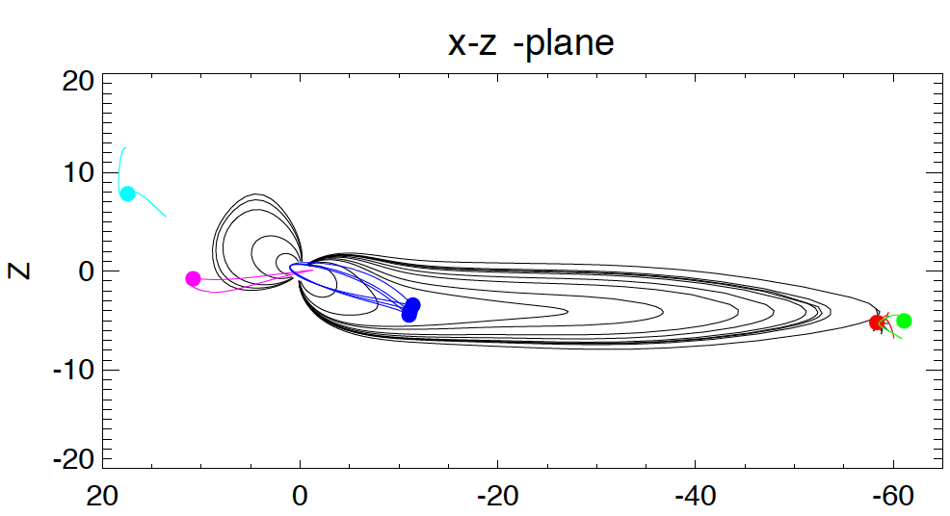
Example of effects of the IMF structure: Substorm triggering by strongly radial, northward IMF
ACE and Wind both
missed the interval of
Strongly radial IMF, which
was seen by Geotail.
Radial IMF resulted in formation of highspeedJets and -30 nT Bz in the magnetosheath which produced enhanced flux loading into tail and initiated a substorm.
Without Geotail and MMS data
there would have been a wrong interpretation about the substorm trigger.
Nykyri+, 2019b

Slide 4
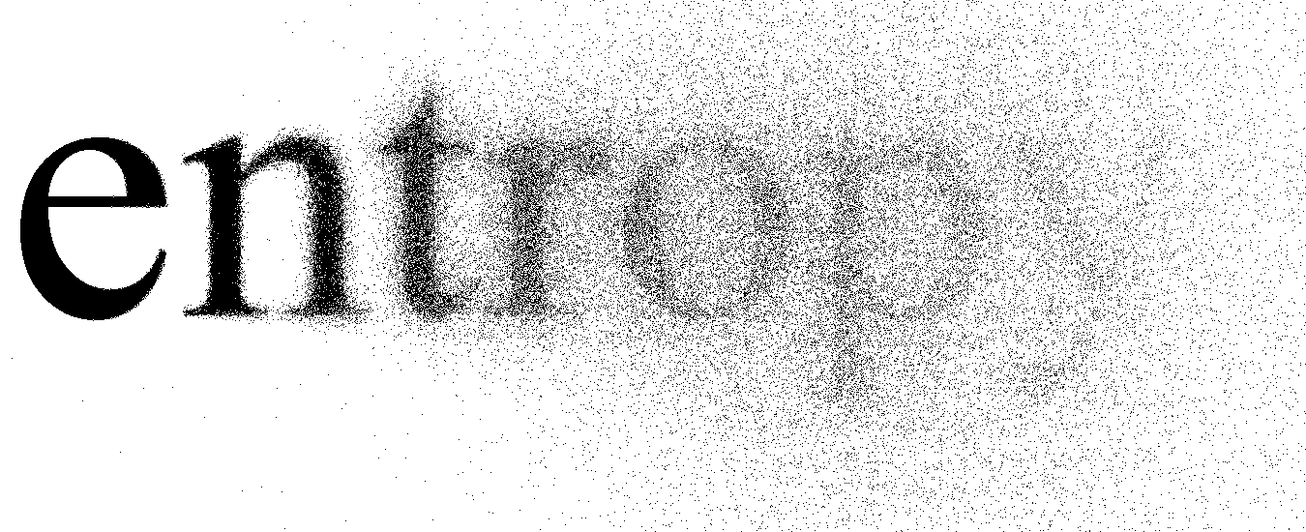
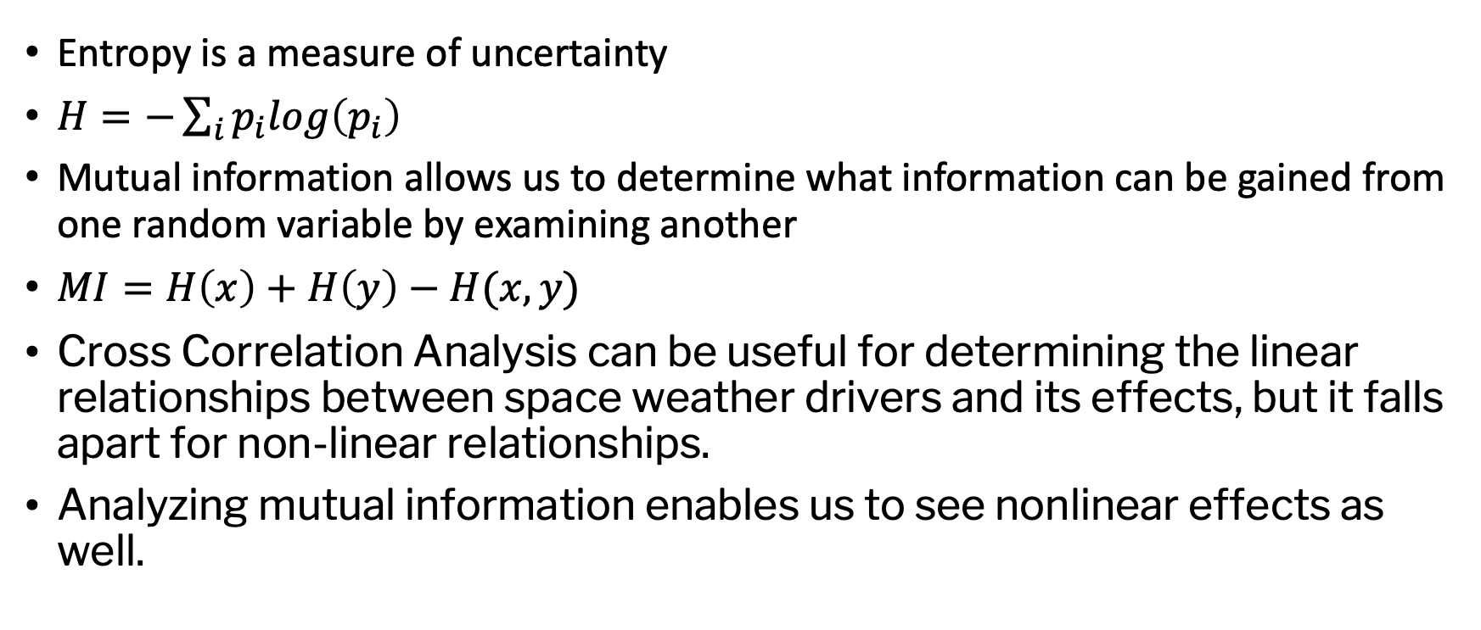
Background
Entropy is a measure of uncertainty
$H=−\sum_{i}{p_{i}log\left(p_{i}\right)}$
Mutual information allows us to determine what information can be gained from one random variable by examining another
$MI=H\left(x\right)+H\left(y\right)−H(x,y)$
Cross Correlation Analysis can be useful for determining the linear relationships between space weather drivers and its effects, but it falls apart for non-linear relationships.
Analyzing mutual information enables us to see nonlinear effects as well.

Slide 5
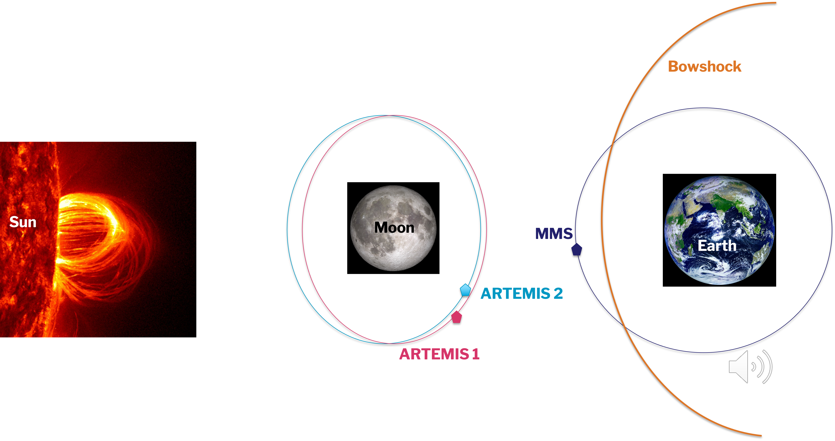
A) Information theory analysis of solar wind (SW) structures as they moved from Lunar orbit toward Earth’s bow shock
Holland+, 2022, in preparation

Slide 6
Methodology
Interpolated MMS1, ARTEMIS 1, and ARTEMIS 2 B data into same time stamps
Created vectors of time shifted MMS1 B data.
Calculated correlation coefficients (cc) and mutual information (MI)
Time lag corresponding to highest cc and MI are recorded.
Estimated time lag also by conducting minimum variance analysis of magnetic field: spacecraft separations (dR) projected along normal (n), SW velocity (V) projected along normal (n) -> dt= dR⦁ n/V⦁ n

Slide 7
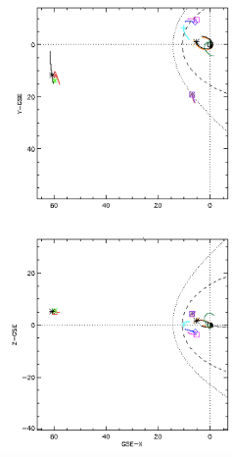
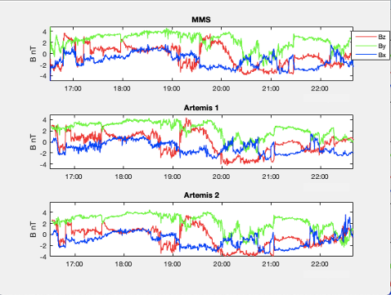
Case-study example
Artemis
Y-GSE
MMS
ΔX ~ 53 Re
ΔY ~9 Re
ΔZ ~0.5 Re
X-GSE
Z-GSE
Holland+, 2022, in preparation
X-GSE

Slide 8
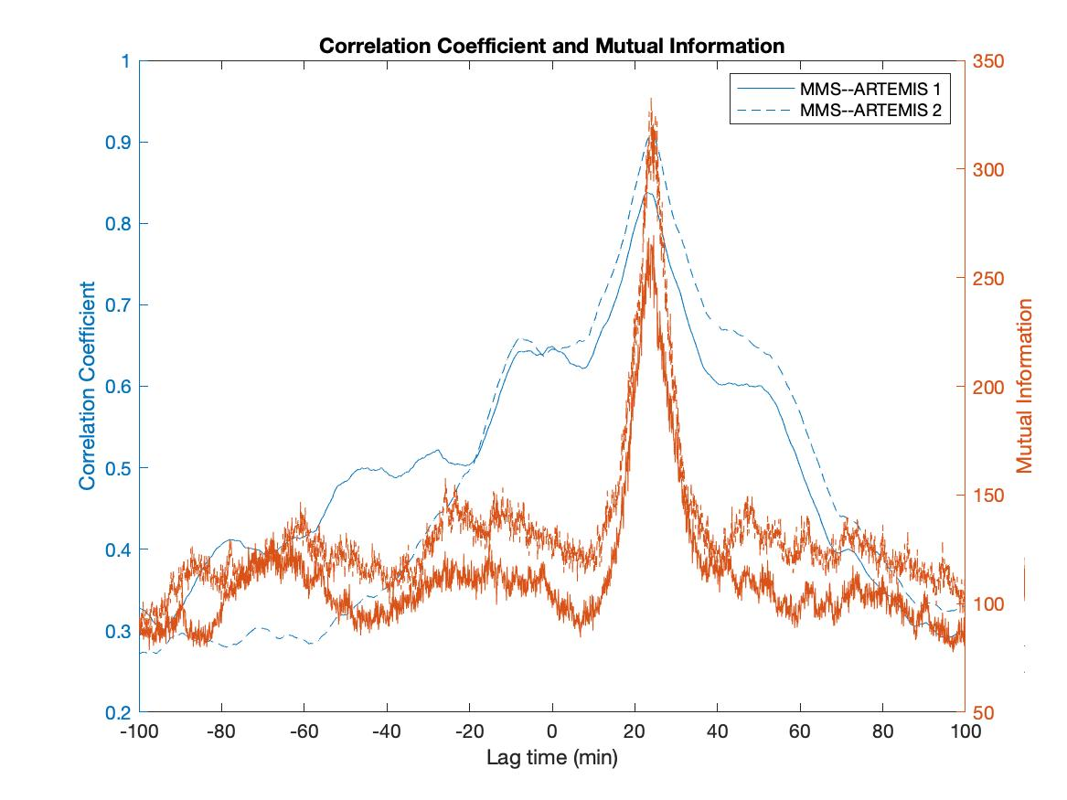
Linear cross correlation coefficients (CC) and mutual information (MM) plotted against lag times.
Both MI and CC peak at about 24 min.
24 minutes
Holland+, 2022, in preparation
Notes:
This slide shows the results for the MI and CC coefficients plotted against time lags. Both the MI and CC cefficients peak at about 24 minutes for this event.
Linear cross correlation coefficients and mutual information plotted against lag times for the same event are shown below. Solid lines represent MMS 1 and ARTEMIS 1 Bx data; dashed lines represent MMS 1 and ARTEMIS 2 Bx data. Both the MI and cross correlation peak at about 24 minutes for this event.

Slide 9
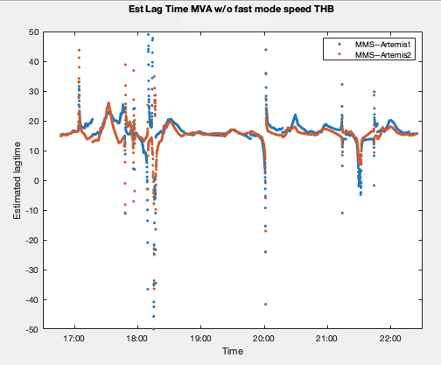
MVAB gives lag time of 15 min.
=>
9 min discrepancy between information travel time and SW propagation time.
MVA:
15 minutes
Holland+, 2022, in preparation

Slide 10
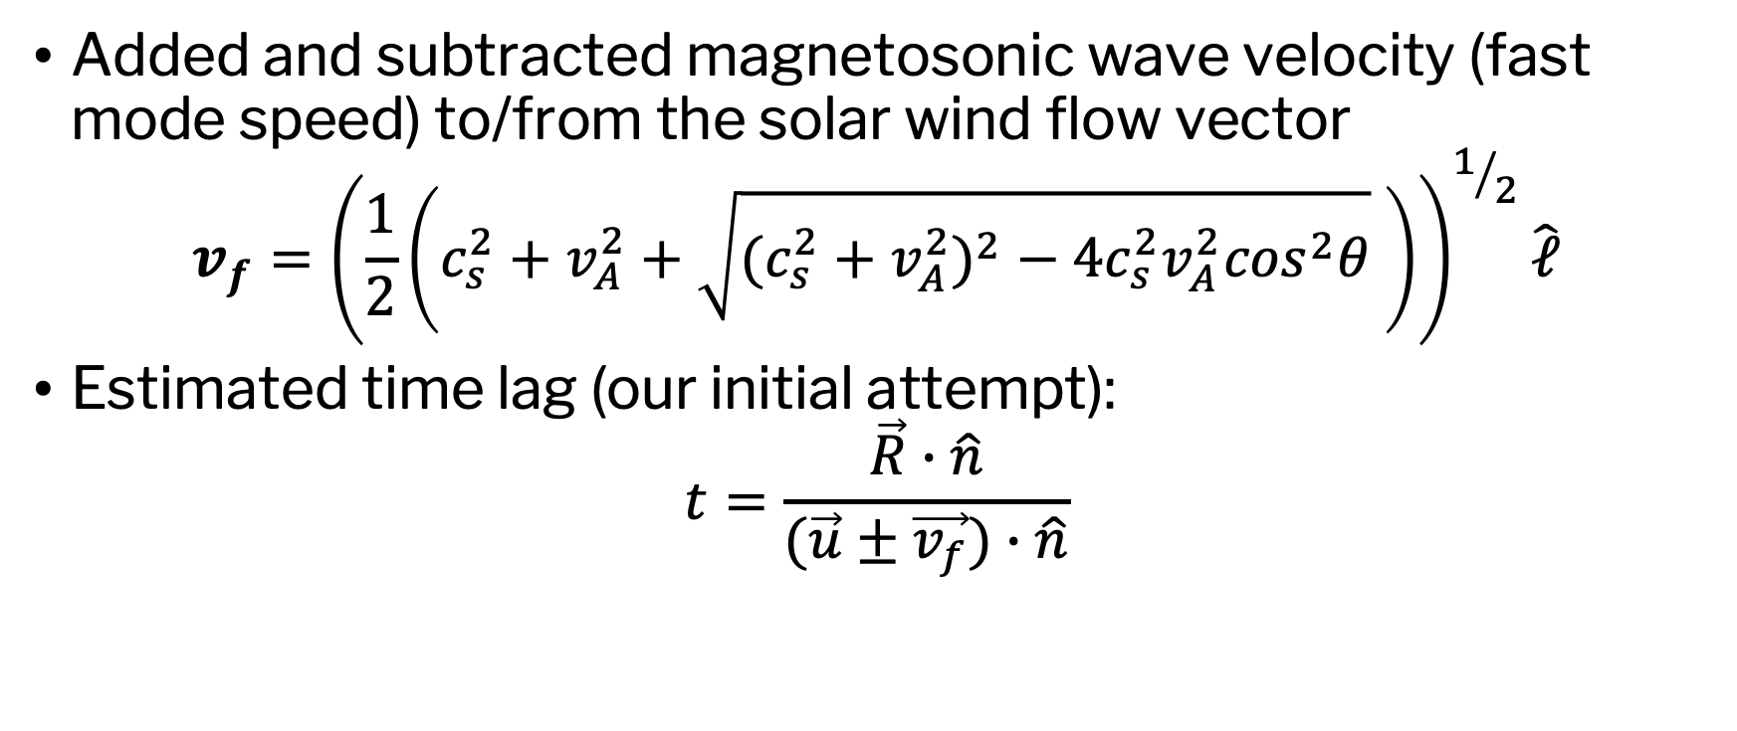
Added and subtracted magnetosonic wave velocity (fast mode speed) to/from the solar wind flow vector
$$v_{f}={\left(\frac{1}{2}\left(c_{s}^{2}+v_{A}^{2}+\sqrt{({c_{s}^{2}+v_{A}^{2})}^{2}−4c_{s}^{2}v_{A}^{2}\cos^{2}θ} \right)\right)}^{1/2}\hat{ℓ}$$
Estimated time lag (our initial attempt):
$$t=\frac{\vec{R}∙\hat{n}}{(\vec{u}±\vec{v_{f}})∙\hat{n}}$$

Slide 11
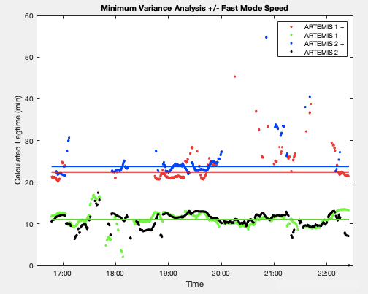

U_{SW} plus fast
mode velocity:
22-24 minutes
U_{SW} minus fast
mode velocity:
10-11 minutes

Slide 12
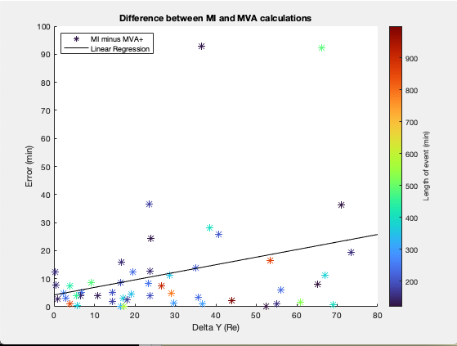
This suggests that the information velocity from the lunar orbit to Earth’s bowshock is the combination of the solar wind flow velocity and magnetosonic wave velocity.
For 49 events the error between
time lag calculations from
MVAB vs MI appears to increase
when ΔY increases.
Holland+, 2022, in preparation

Slide 13
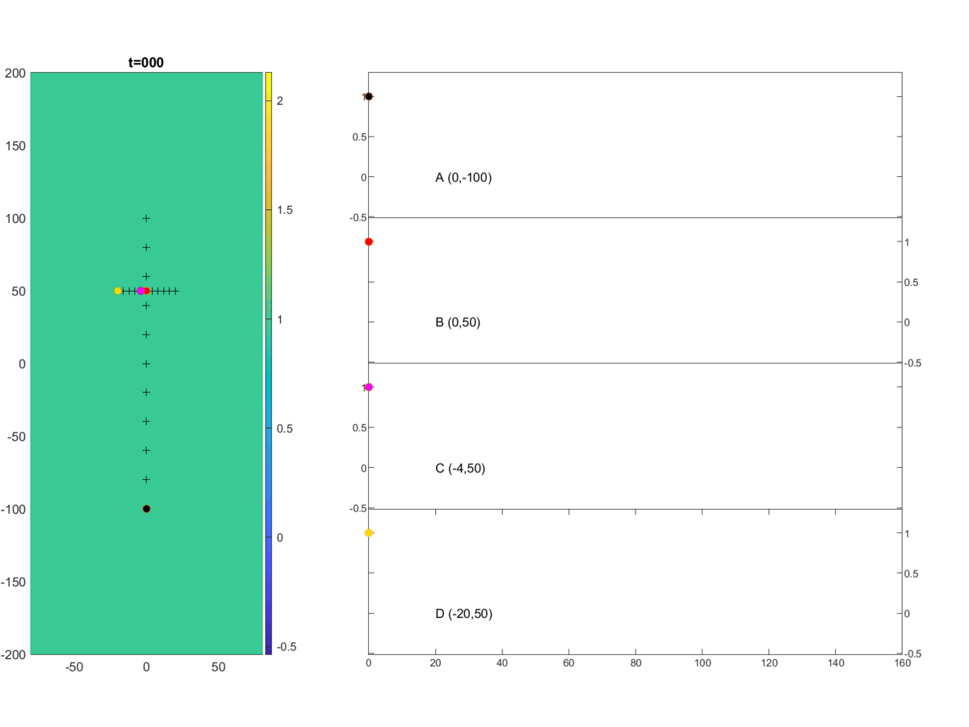
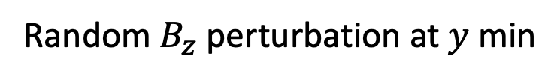
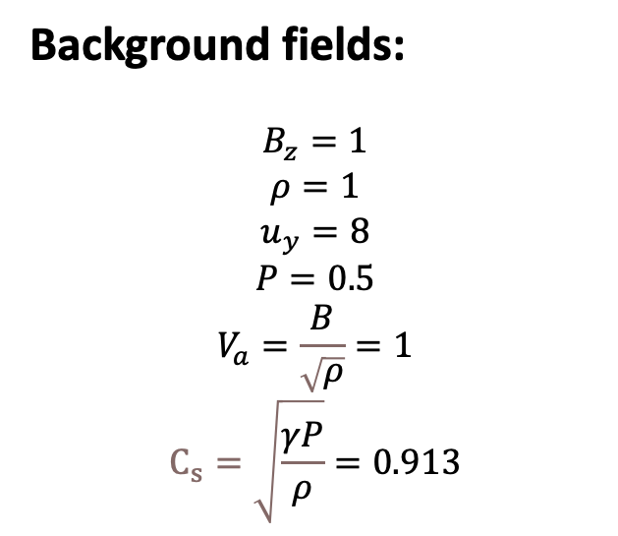
Validation: MI in MHD SW Simulation with
upstream B_{z} perturbation
Background fields:
$$B_{z}=1$$
$$ρ=1$$
$$u_{y}=8$$
$$P=0.5$$
$$V_{a}=\frac{B}{\sqrt{ρ}}=1$$
$$C_{s}=\sqrt{\frac{γP}{ρ}}=0.913$$
y
Random $B_{z}$ perturbation at $y$ min
x
Notes:
This animation shows a 2-D “solar-wind-like” MHD simulation. In this simulation, we use a uniform background, in which density is one, magnetic Bz is one, and bulk velocity is 8. Notice, the bulk velocity is much larger than the local sound speed and Alfven speed. The black crosses indicate the location of the virtual satellite in the simulation. Satellite B is in the downstream of Satellite A. Satellite C and D are away from the downstream of Satellite A. The right plane shows magnetic Bz from black, red, pink and yellow point. We add some random magnetic Bz perturbation at y minimum boundary. As you can see the perturbation has been advected by the solar wind from upstream to the downstream, meanwhile it propagates along the all the directions.

Slide 14
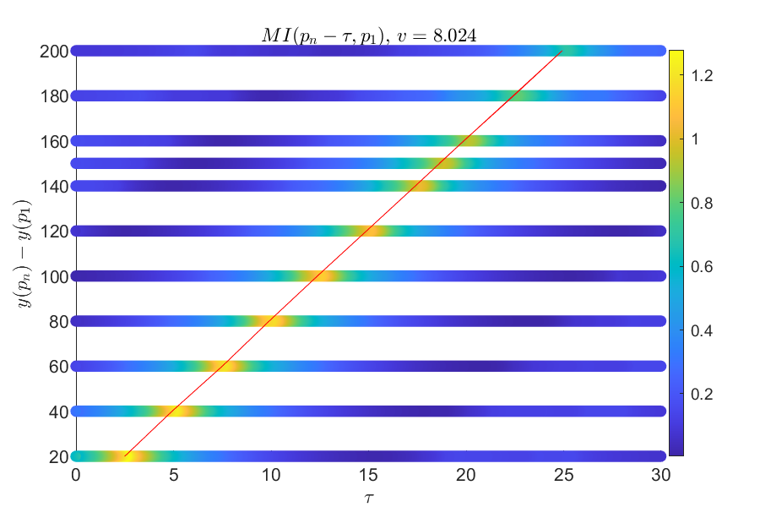
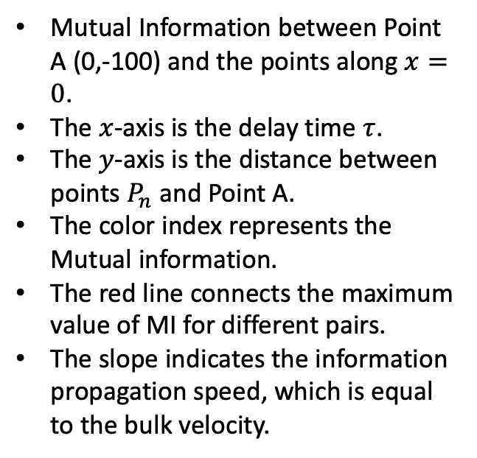
Information speed, as calculated from spatially separated points along bulk flow, is equal to the bulk velocity
Mutual Information between Point A (0,-100) and the points along $x=0$.
The $x$-axis is the delay time $τ$.
The $y$-axis is the distance between points $P_{n}$ and Point A.
The color index represents the Mutual information.
The red line connects the maximum value of MI for different pairs.
The slope indicates the information propagation speed, which is equal to the bulk velocity.
Notes:
In this slide we calculate the mutual information between Satellite A and its downstream satellites N, which is given by MI( A(t-tau),N). Here, the y-axis shows the distance between Satellite A and the other Satellites N. The x-axis shows the delay time, tau, between Satellite A and N. The color index represents the Mutual A(t-tau,N). Here we pick the maximum value for each pair of satellite. Thus, the slop of this red line represents the velocity of the information speed, which is equate to the bulk velocity. This is consistent with our expectation.

Slide 15
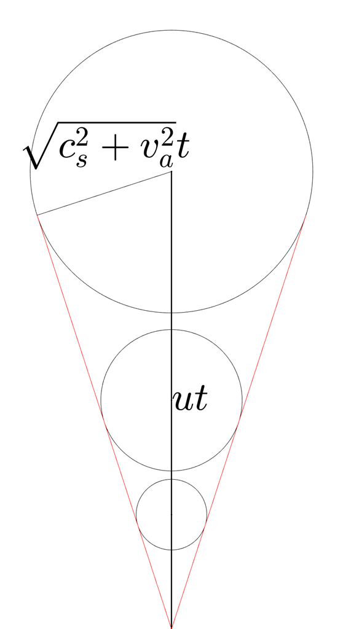
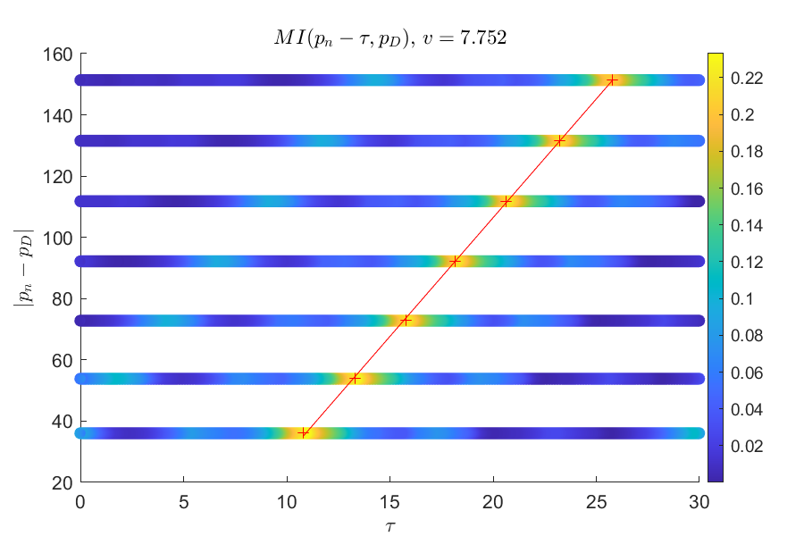
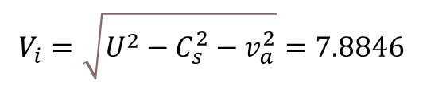
Information speed is smaller than the bulk velocity away from bulk-flow direction
Mutual Information between Point D (-20, 0) and the points along $x=0$.
Notes:
How about information propagation away from the x-axis? In this plot Here we calculate the mutual information between Satellite D and the satellites located perpendicular to SW flow (along the x-axis). In this case, the slope is about 7.752 which is smaller than the bulk velocity. Notice, in this case, the fast mode propagates in the plane that is perpendicular to the Bz component. As illustrate in the right plot, for any given point in the red cone, the speed of information is given by sqrt(u^2-v_f^2), which is about 7.88 in this case. Notice the values for both cases are not exactly match, because the perturbation change the Bz, and consequently change the local fast mode speed. This simple simulation also illustrates that in the solar wind the upstream perturbation may not affect the downstream condition, if the downstream measurement is taken away from the red cone.

Slide 16
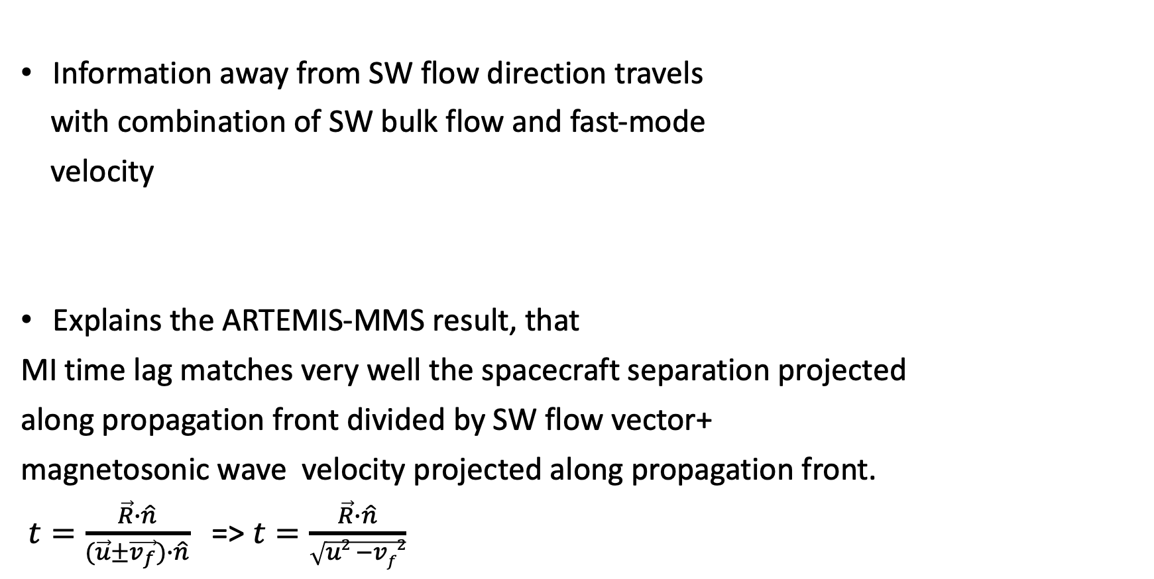
MHD simulations:
Information away from SW flow direction travels
with combination of SW bulk flow and fast-mode
velocity
Explains the ARTEMIS-MMS result, that
MI time lag matches very well the spacecraft separation projected
along propagation front divided by SW flow vector+
magnetosonic wave velocity projected along propagation front.
$t=\frac{\vec{R}∙\hat{n}}{(\vec{u}±\vec{v_{f}})∙\hat{n}}$ => $t=\frac{\vec{R}∙\hat{n}}{\sqrt{u2 −vf2}}$

Slide 17

Takeaway Message
Single satellite measurement at L1 (even exactly upstream of Earth)
might miss the actual SW structure that affects the Earth if L1 point is not within the cone of influence of information propagation
for that perturbation.
L1
SW or IMF perturbation

Slide 18
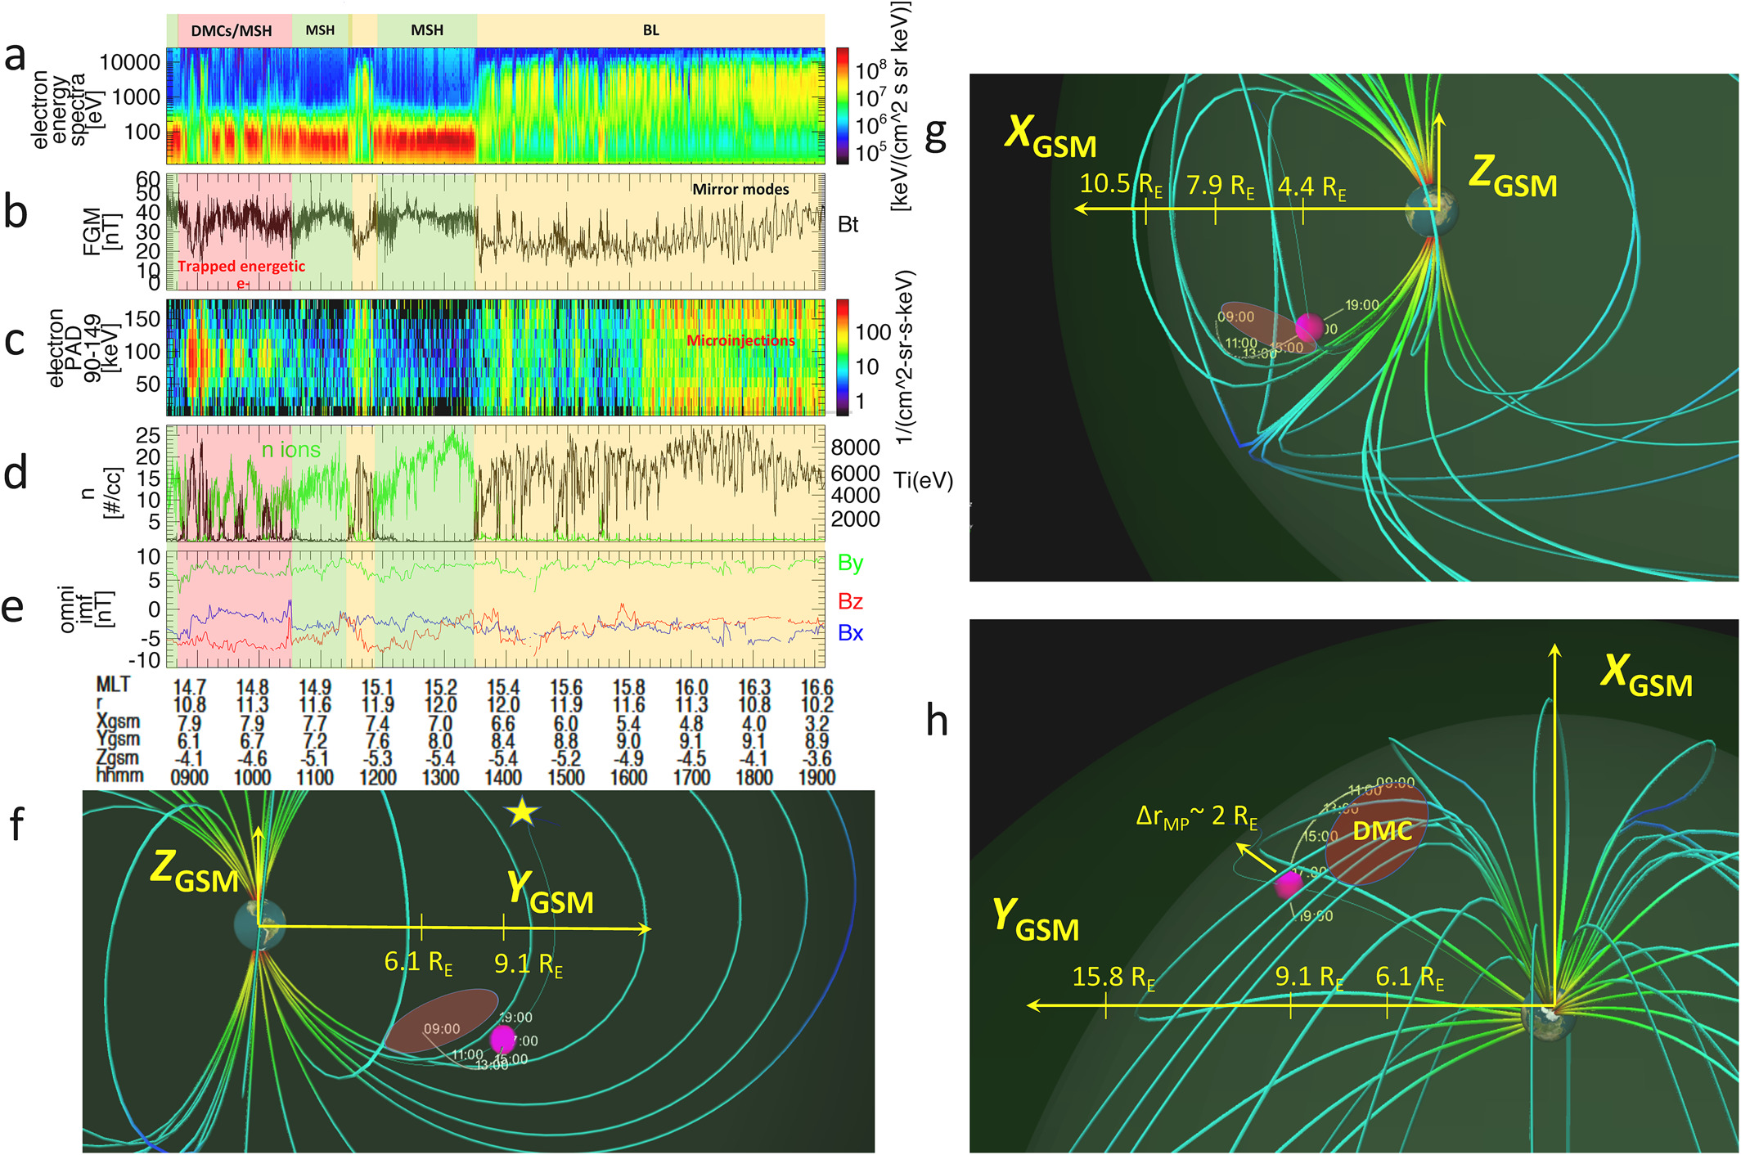
Motivation
B) Tracing Plasma Transport Pathways at Magnetospheric Boundary
We want to understand the origin and fate of the counter-streaming
energetic electrons (dispersionless microinjections) at the high-latitude boundary layer.
Are they coming from large-scale (2-4 R_{E}) diamagnetic cavities (DMCs) created by magnetic reconnection
or from radiation belts?
Step 1: We utilize mutual information (MI) and Transfer Entropy (TE) to study connection between DMCs and microinjections.
Nykyri+, 2019a, JGR; Nykyri+, 2021, GRL

Slide 19
Additional Methodology:
Transfer entropy (TE) can be considered as a specialized
case of conditional mutual information that connects the past state of a variable with its future:
Unlike correlational analysis and mutual information, transfer entropy is directional.

Slide 20
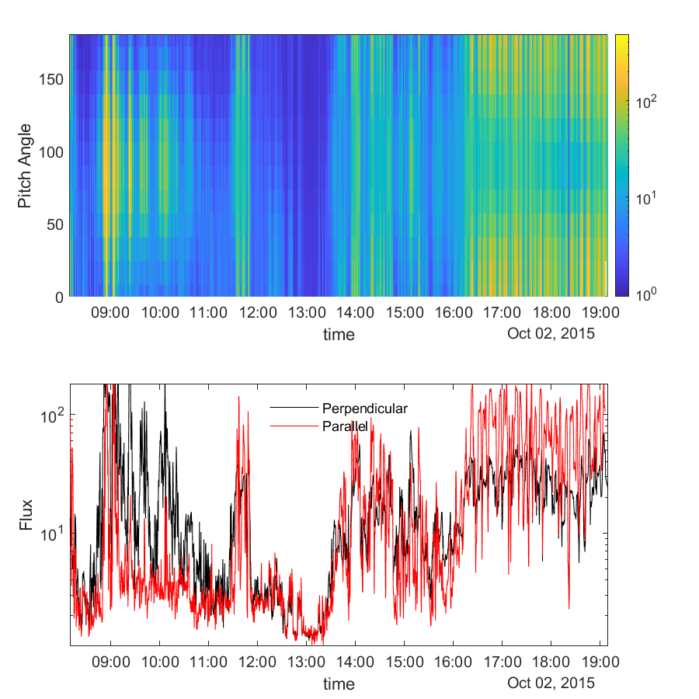
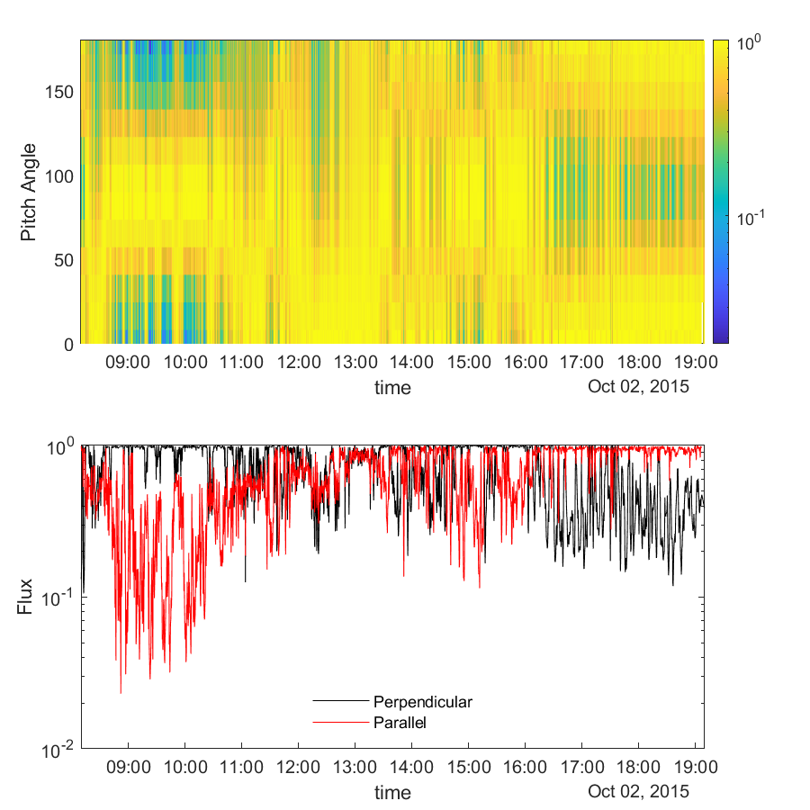
MMS FEEPS electron PAs distributions at 70-500 keV
MMS FEEPS electron PAs normalized to max. flux
Notes:
The top left panel shows electron’s pitch angle distribution for energy between 70-500 keV on Oct 02,2015. The bottom is the flux for perpendicular flux (black line) and parallel flux (red line). Here the perpendicular flux is given from the geometric average of the flux in 82 and 98. degree, and parallel flux is given from the geometric average of flux in 0 and 180. The right panel show the same data but for each given time the pitch angle distribution is normalized by its maximum value. The right bottom panel shows the normalized the perpendicular flux (black line) and parallel flux (red line).

Slide 21
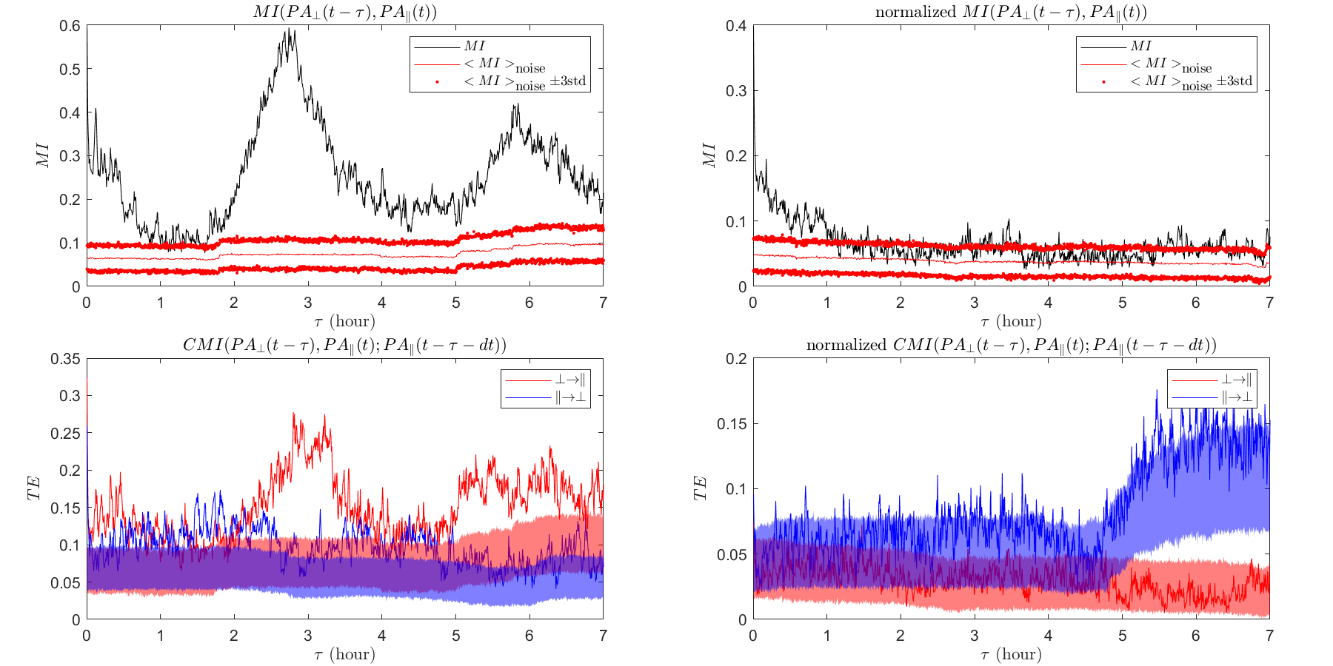
Notes:
The top row shows the Mutual information between Parallel and Perpendicular non-normalized flux (left) and normalized flux (right). Red lines show the background noise and its 3 std. The MI for non-normalized flux has peaks at 2.7 and 6 hours, suggesting that the perpendicular flux is 3 or 6 hours ahead than parallel flux. However, after checking the self-MI for parallel and perpendicular flux, we figure out this 2.7-hour speak is consistent with its own periodicity, which means this peak can be simply caused by its periodicity, instead of taking 2.7 hours for information transfer from perpendicular flux to the parallel flux. While the normalized flux has peak at 0 lag time.
The bottom row shows the Transfer Entropy between Parallel and Perpendicular non-normalized flux (left) and normalized flux (right). The transfer entropy is a specific case of conditional mutual information. Here, for the non-normalized flux, the dt is 2.7 hour, which means we remove the information from periodicity. But the results still show peak at 3ish-hour, suggesting there is information transfer from perpendicular to parallel flux. Of course, the results also indicate some information prorogates from parallel to perpendicular. Meanwhile, the normalized flux results say the information is almost fully transfer from parallel flux to perpendicular, which takes about 5-7 hours. Notice the normalized flux remove the information of total flux, but only indicates which pitch angle has the maximum flux.

Slide 22
Takeaway message:
Expected to find that TE has a peak from perp to parallel with lag time of about 7 hrs.

Slide 23
Takeaway message:
Instead we found (not normalized fluxes) that TE has a peak from perp to parallel with lag time of about 3 hrs and from 5 to 7 hrs.

Slide 24
Takeaway message:
We also found (normalized fluxes) that TE has a peak from para to perp with lag time of 5 to 7 hrs.
Interpretation: void of parallel fluxes correlates
with void of perp-fluxes after 5 to 7 hrs because
TE picks also anti-correlation.
These results suggest the trapped energetic
electrons in the DMCs could be the source for
energetic electron microinjections.

Slide 25
Summary for A & B
Mutual information is a powerful technique to uncover lag times for non-linear correlations.
Transfer entropy analysis is a powerful method to uncover the cause and effect.

Slide 26
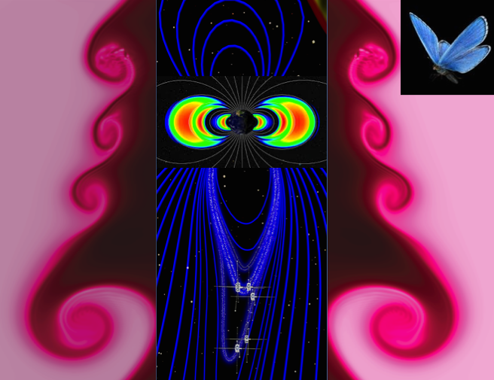

New Neural Network for Kp Forecasting
Motivation: Certain scale size
velocity and B-field fluctuations
can affect the growth of Kelvin-Helmholtz instability and size of waves at the magnetopause boundary [Nykyri+, 2017; Nakamura+, 2020]. KH waves generate Pc3-Pc5 range ULF waves that can interact with radiation belt electrons.
=>
recurrent neural network is trained on 30 years of historical data from NASA’ s Omni virtual observatory (with combination of different training parameters, including
fluctuations ) and forecasts Kp with a prediction horizon of up to 24 h.

Slide 27

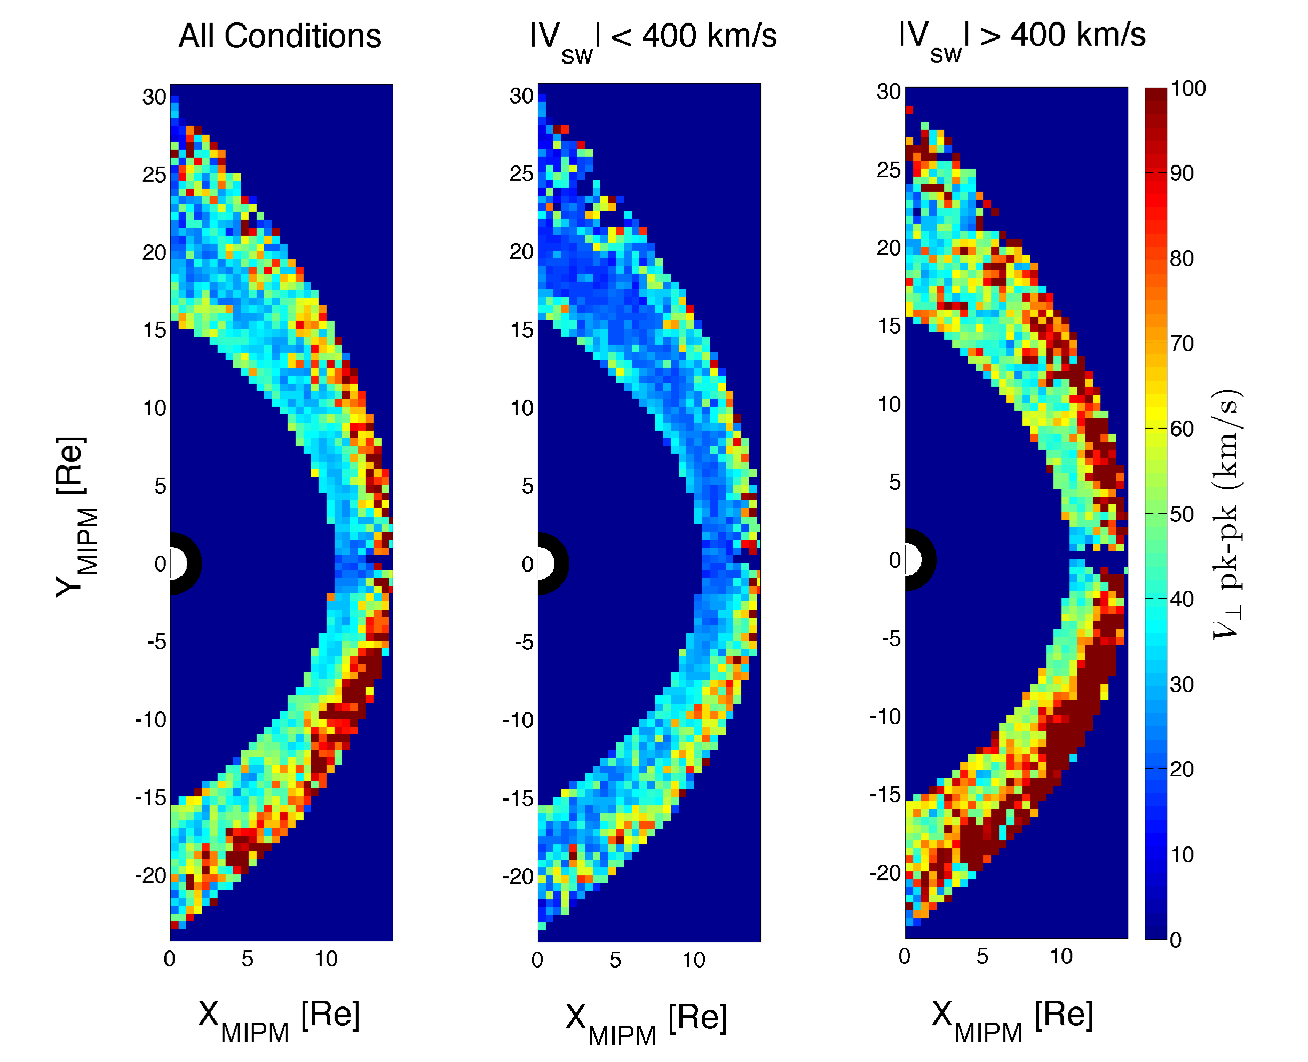
Effect of Seed Velocity Fluctuations on the KHI
KHI can drive Pc3-Pc5 range geomagnetic pulsations.
Magnetosheath velocity fluctuations are more enhanced downstream of quasi-parallel shock.
Seed frequency equal to the theoretical fastest growing mode produces a larger KH wave than the high frequency seed.
May help explain geo-effectives of certain solar wind structures
Nykyri et al., 2017, JGR

Slide 28
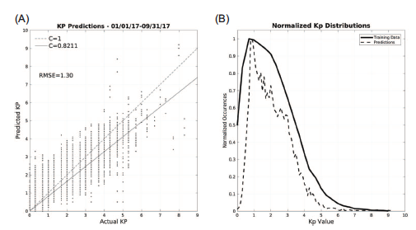
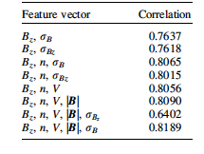
Including IMF |B| fluctuation level improves performance of ANN
for 24 hr advanced Kp prediction.
Caveat: Omni data which uses propagated L1 data from Wind and ACE. The measured
structures may not always impact the Earth -> wrong learning.
Idea for Future work: Consider information cone of influence between satellite
measuring feature vectors.
Notes:
6528 Kp predictions 01/01/2017–09/30/17 from the network trained on the original Wing model inputs with an additional
parameter: Bz, n, V, |B|, d|B|.
(B) Frequency of Kp values for full data set 1986–2016 and 2017 predictions. Compared with Figure 5, the
distribution of predictions more closely matches that of the training set.
The addition of dBz to the feature vectors
consistently decreases prediction accuracy, and the effect is
most pronounced on the Wing et al. (2005) features. We attribute
the loss of accuracy to the model reaching a local minimum
in training that it avoids when rBz is withheld from the training
data.
Matlab’ s Neural Network Toolbox was used to build the
MLP model, starting with a single hidden layer of 10 neurons
and a linear output layer. Prior to defi ning the full set of features
and fi nal network architecture, the network was trained on the
full data set with Bz as the only input, and its ability to predict
a single time step ahead was evaluated. Initial tests were conducted
to determine the maximum viable input lag time, s ,
for this study, and with Bz as the only input s > 36 yielded
diminishing returns in predicition accuracy.
A parametric study was conducted to determine the ideal
number of neurons in the hidden layer, as too few neurons leads
to a poor fi t of the model, and too large of a hidden layer
increases computational costs with diminishing returns as well
as introduces a vulnerability to overfi tting, as indicated by the
cyan line in Figure 1 .
A toy model is shown

Slide 29
Thank you!

